Slide 1
IBM University Engagement Project Submission
“Exploring the Power of Agentic AI with IBM Cloud and Orchestrate”

Slide 2

Project Tile – AI-POWERED JOB RECOMMENDATION & CAREER ASSISTANCE PLATFORM
Domain of Project – EDUCATION / AI
Student Name | Recent Passport Photo | Email ID | Mobile number [WhatsApp]
SHRUTI CHAURASIA |  | shrutic.chaurasia@bbdnitm.ac.in | +91 8765244270

Slide 3

PROBLEM STATEMENT -
Problem Statement : AI-Powered Travel Agent & Trip Planner using IBM watsonx Orchestrate
Planning a trip can be stressful because users have to search multiple websites for flights, hotels, travel packages, and destination information. They also struggle to find personalized travel recommendations based on their budget and interests. There is a need for an AI-powered travel assistant that can simplify travel planning, provide personalized recommendations, answer travel-related queries, and help users make better travel decisions.

Slide 4

OBJECTIVES -
Build an AI-powered Travel Assistant.
Provide personalized travel recommendations.
Suggest destinations based on user preferences.
Help users discover travel packages.
Provide AI-based travel guidance.
Improve user travel planning experience.
Integrate IBM watsonx Orchestrate AI Chatbot..

Slide 5

TECHNOLOGY USED -
IBM watsonx Orchestrate
IBM Granite Model
IBM Cloud Lite
HTML5
CSS3
JavaScript
Visual Studio Code
GitHub

Slide 6
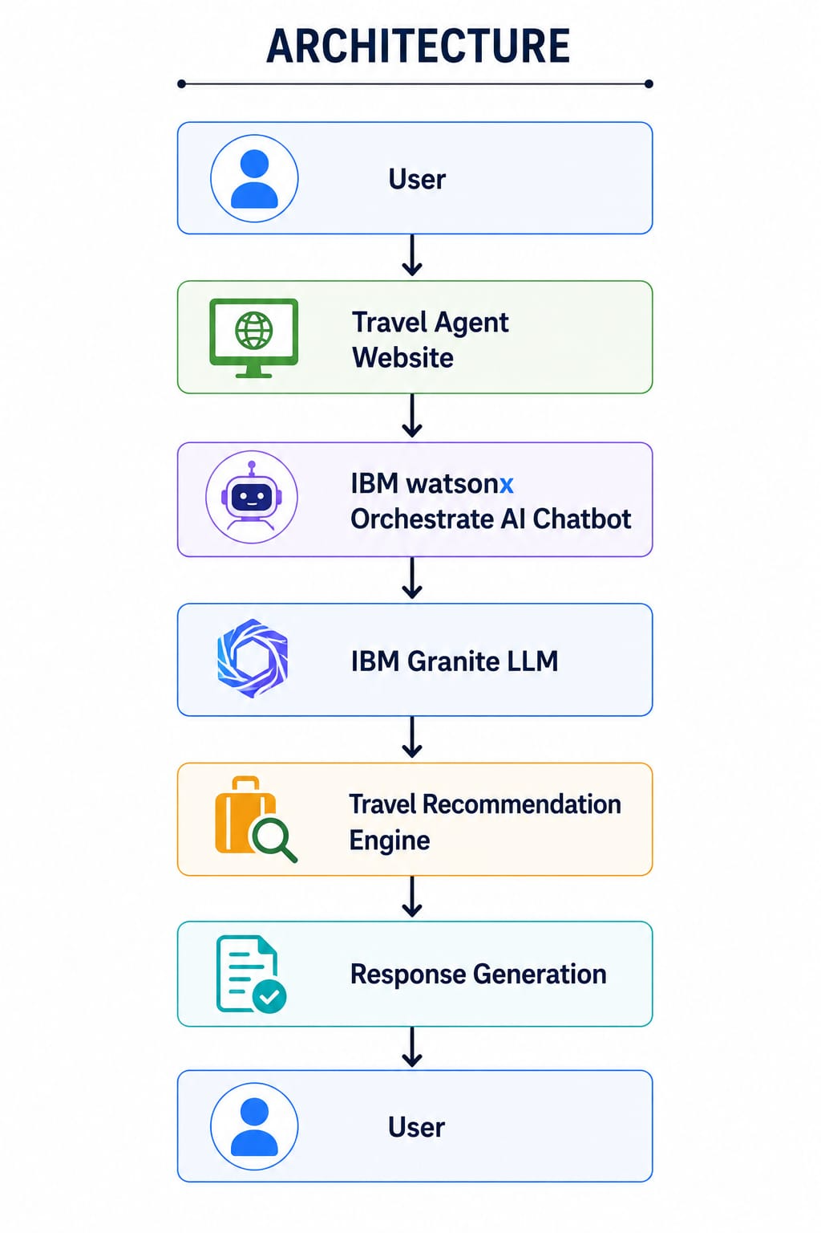


ARCHITECTURE -

Slide 7
IBM ORCHESTRATE COMPONENTS -
AI Chat Assistant
IBM Granite LLM
Prompt Engineering
Travel Recommendation System
Conversation Management
Response Generation

Slide 8
IBM
ORCHESTRATE

Slide 9

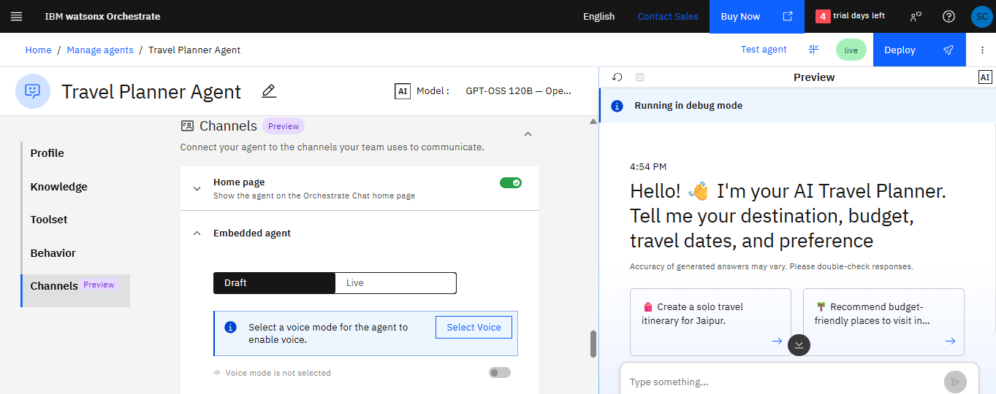
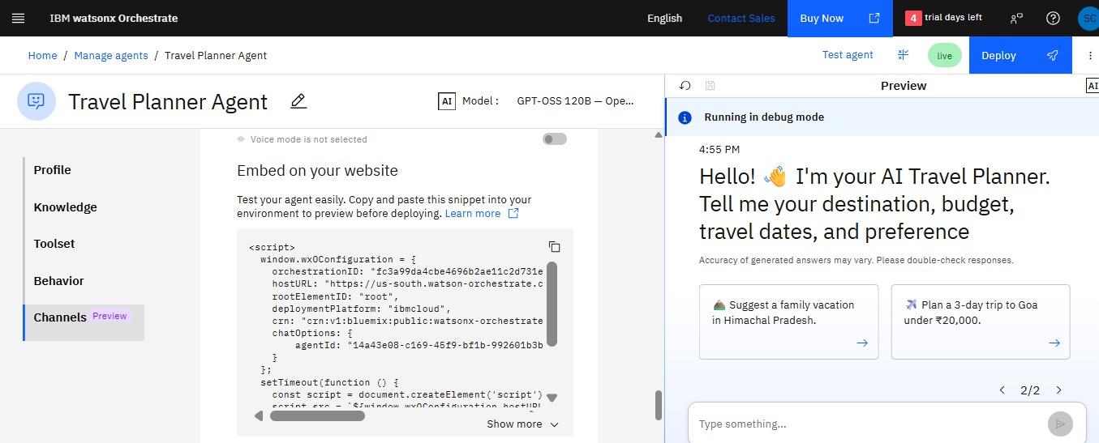

Slide 10
USER INTERFACE

Slide 11
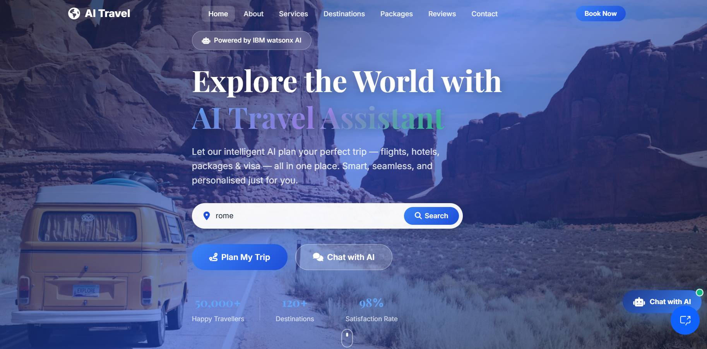
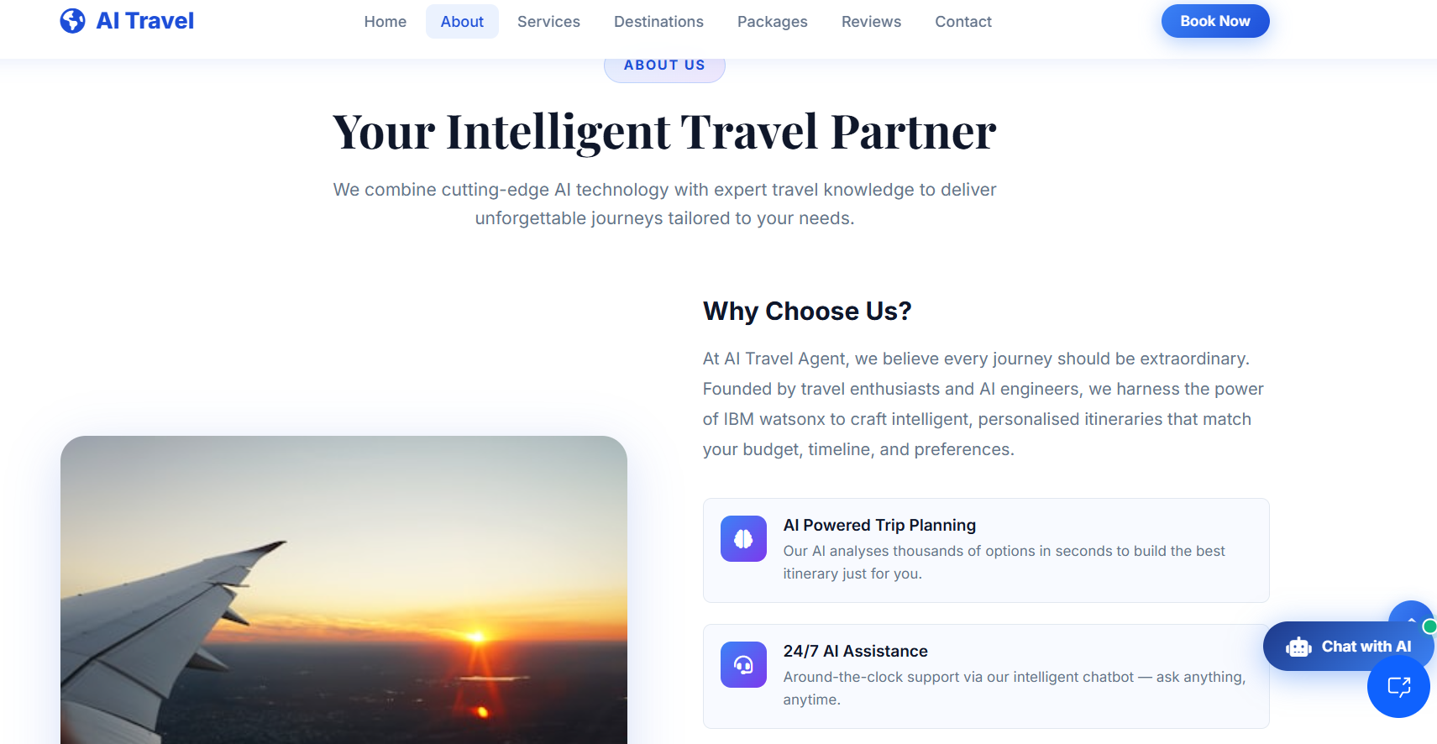
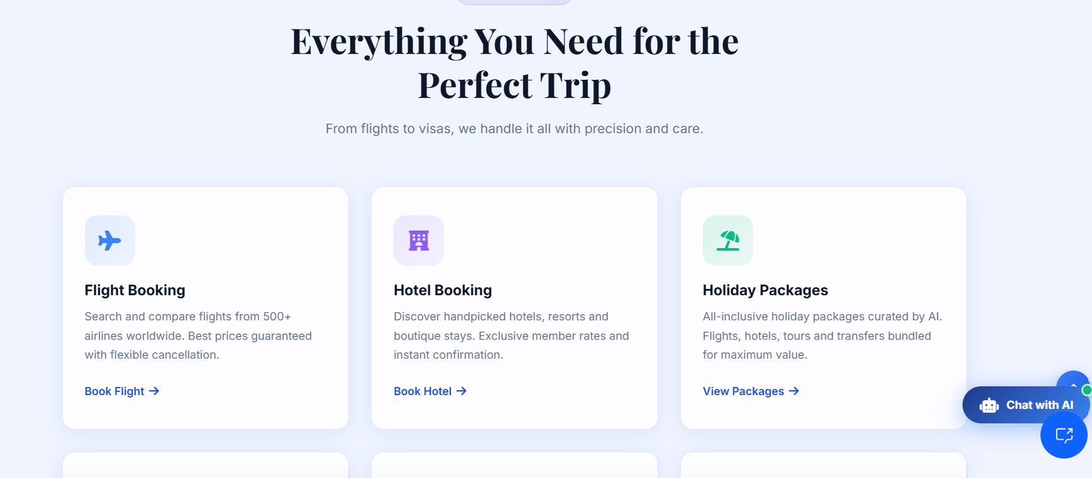
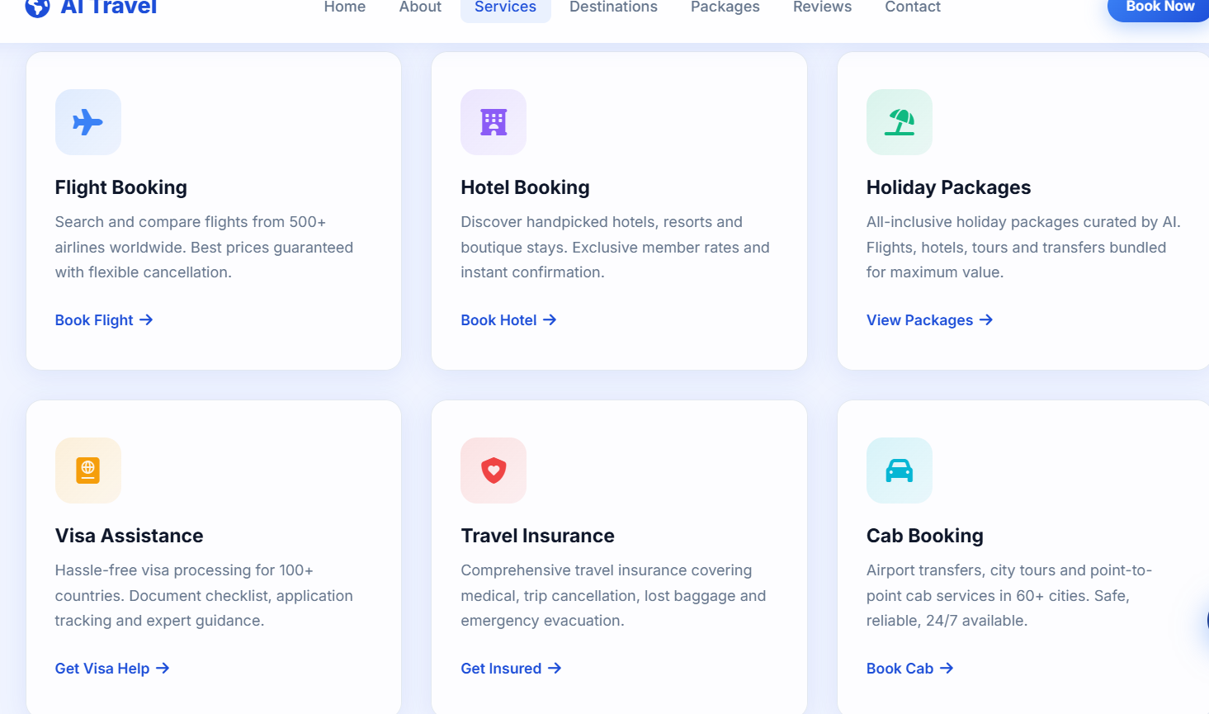
INTERFACE SCREENSHOTS -

Slide 12
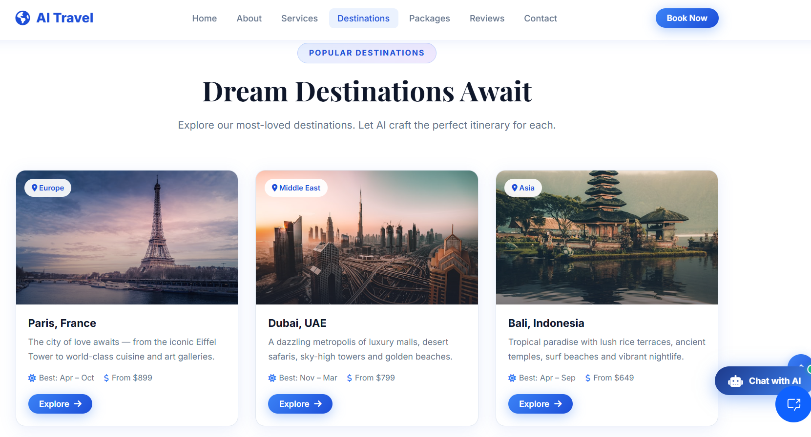
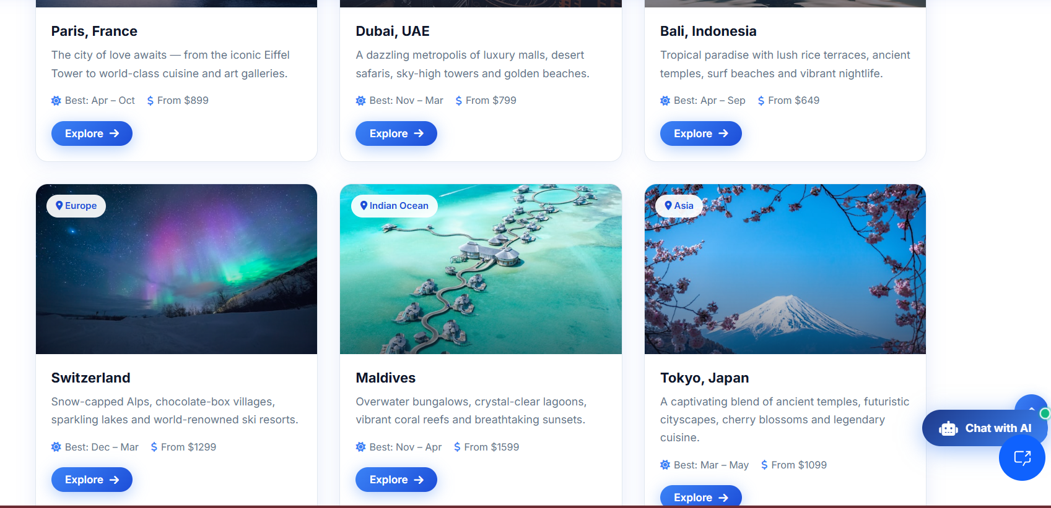
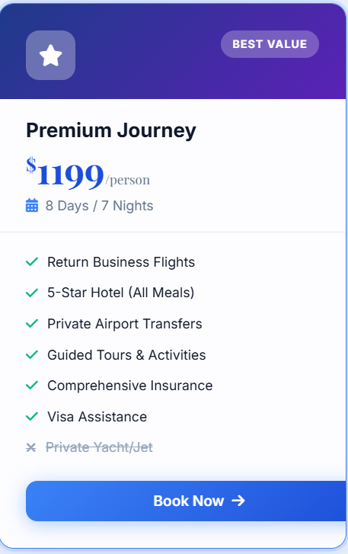
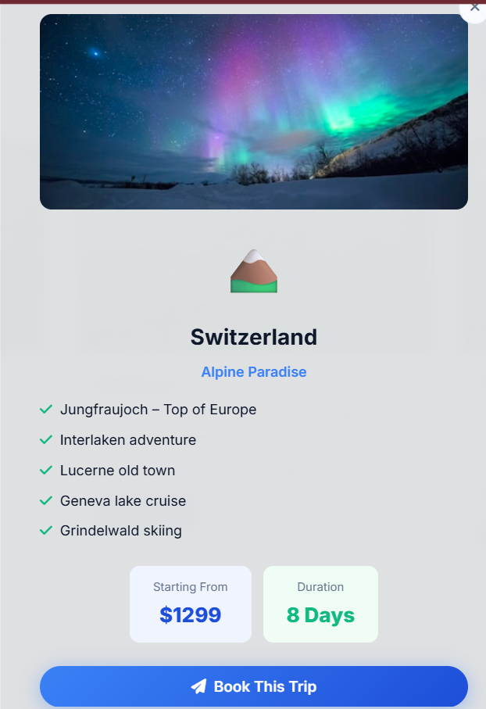
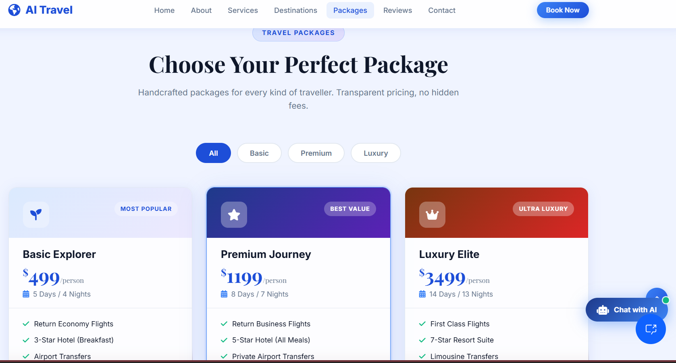

Slide 13
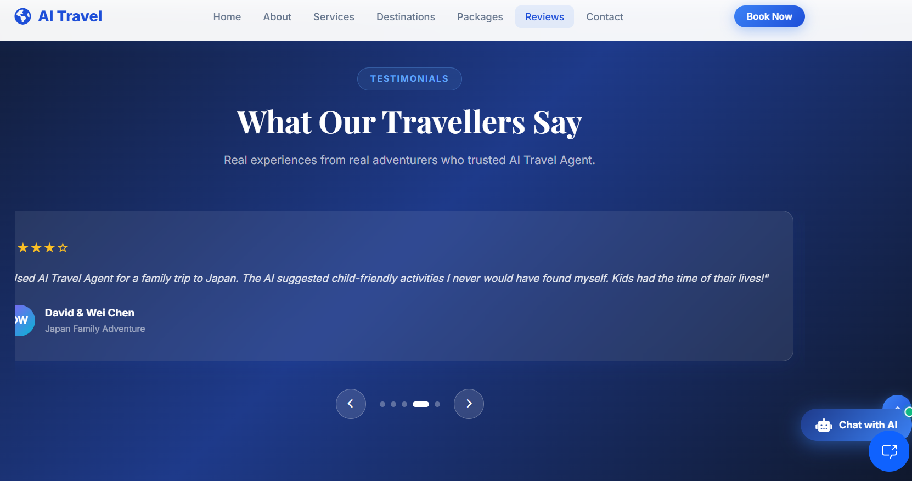
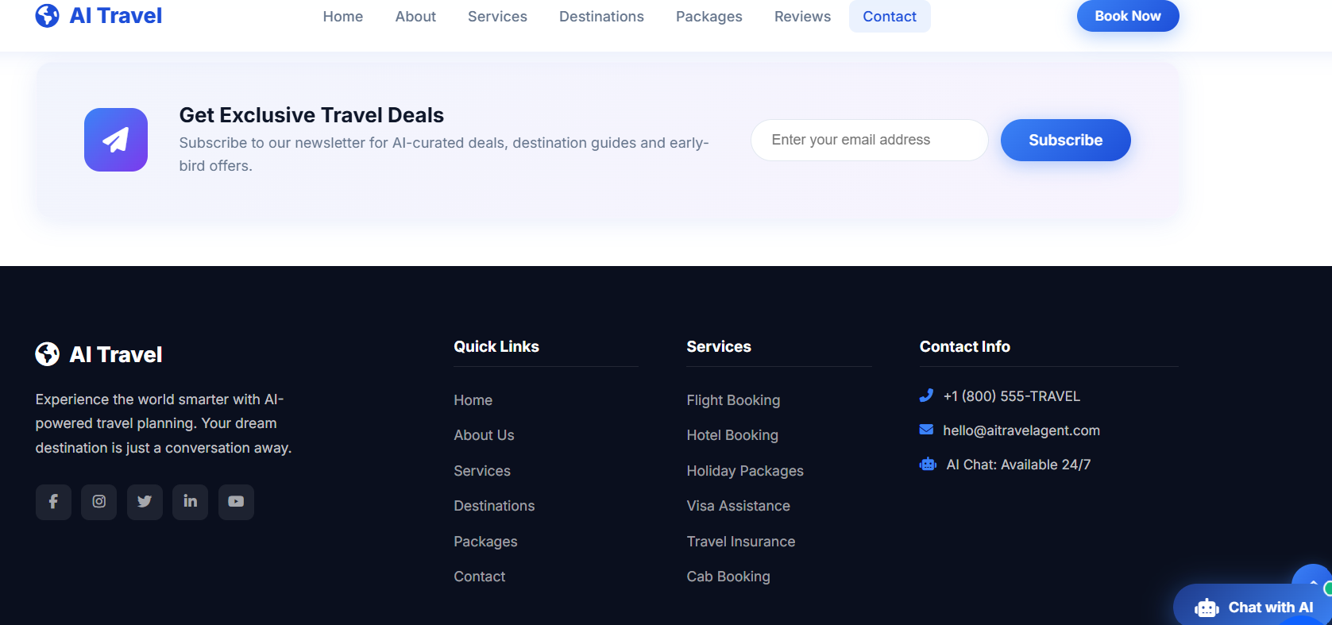

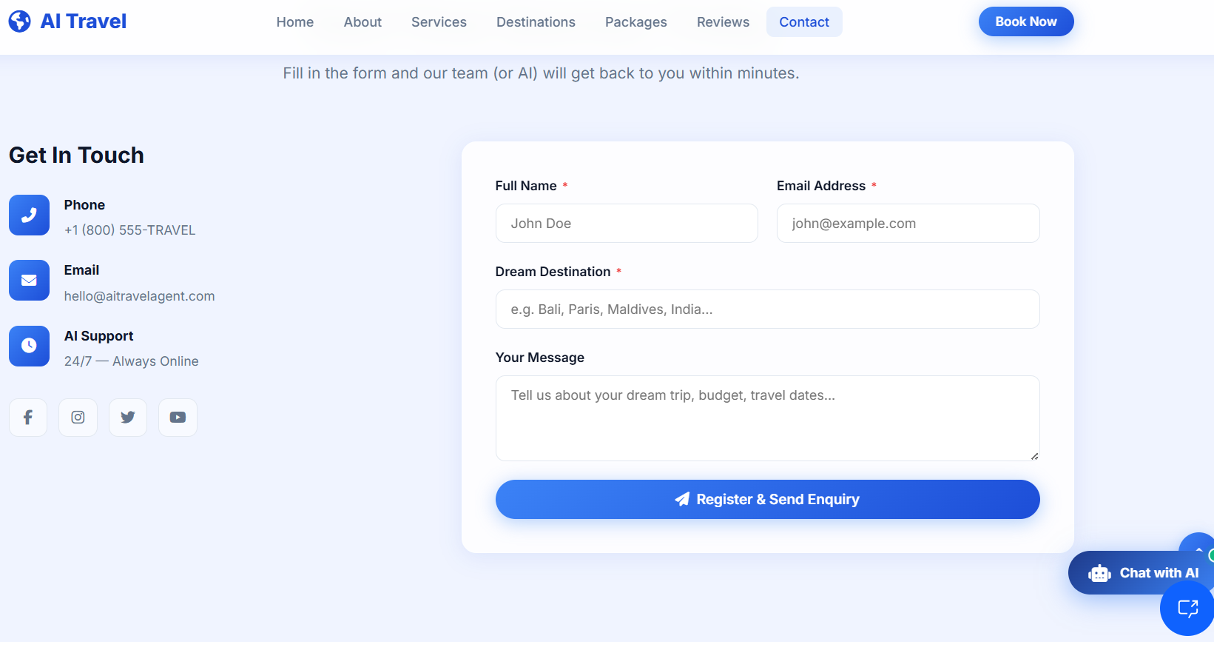

Slide 14
IBM
BOB

Slide 15
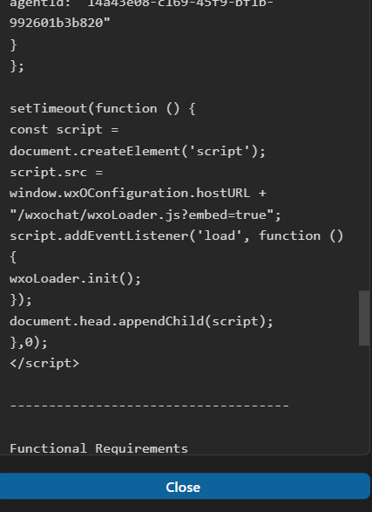
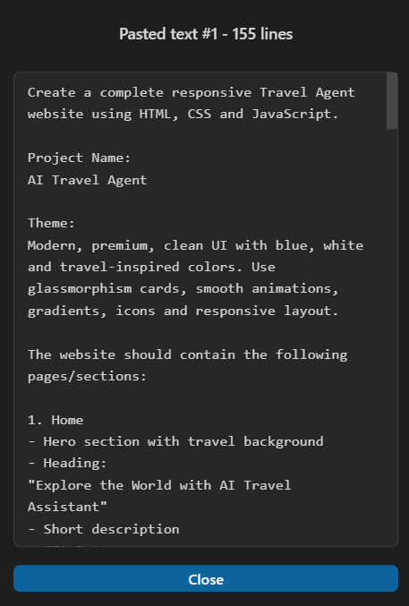
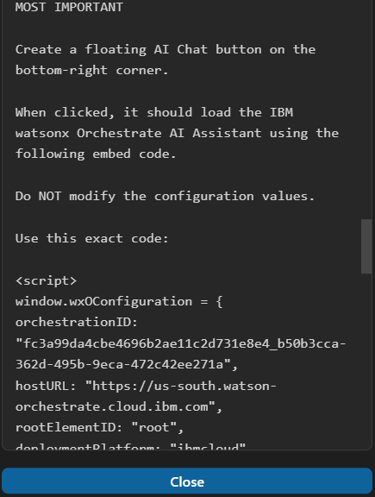
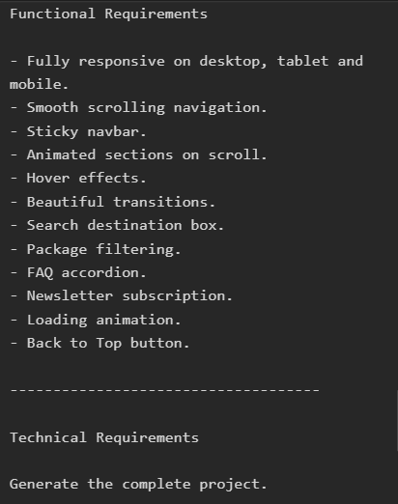
BOB SCREENSHOTS -
BOB INITIAL PROMPTS

Slide 16
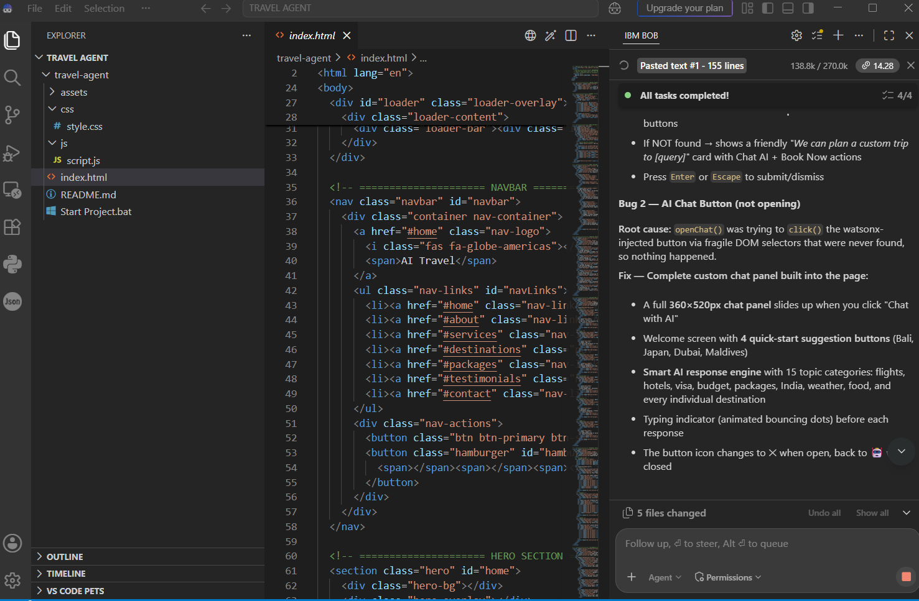
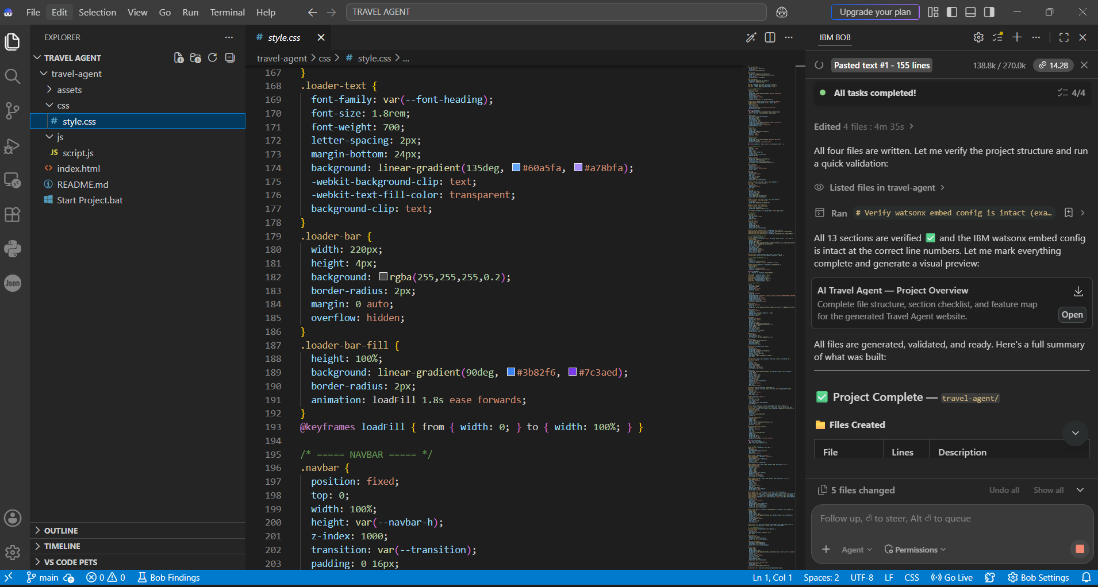
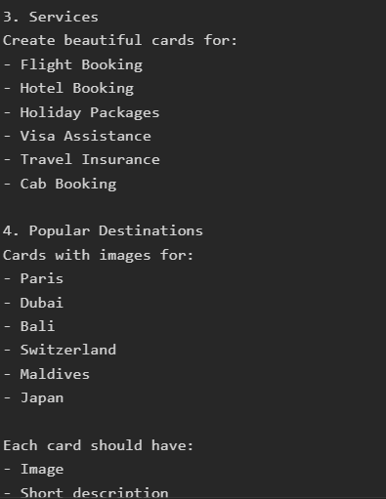

Slide 17
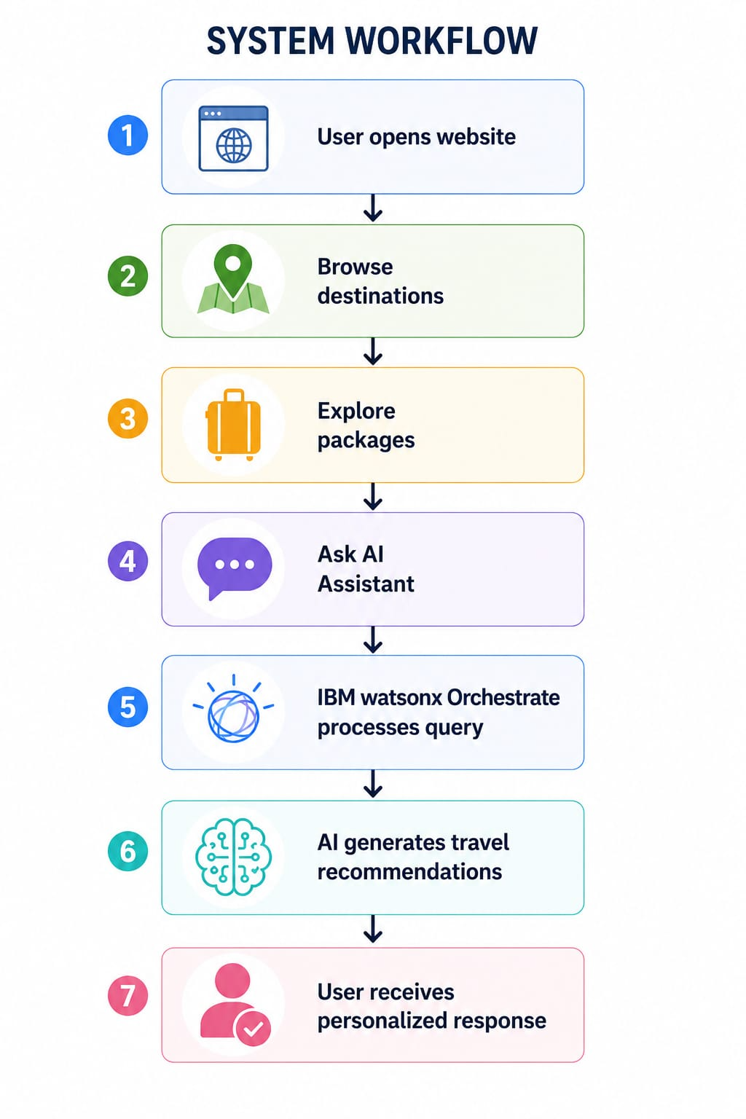
SYSTEM WORKFLOW -

Slide 18

FEATURES -
AI Travel Assistant
Destination Recommendations
Holiday Packages
Hotel Information
Flight Guidance
Travel Planning
Responsive Design
Contact Form
IBM watsonx Orchestrate Chatbot
Modern User Interface

Slide 19

BENEFITS -
Saves travel planning time
Personalized travel recommendations
24×7 AI Assistance
Easy trip planning
Better travel experience
User-friendly interface
Instant answers to travel queries

Slide 20

FUTURE SCOPE -
Hotel Booking Integration
Flight Booking API
Weather Forecast
Google Maps Integration
Budget Planner
Visa Guidance
Travel Expense Calculator
Multi-language Support
Mobile Application
Voice Assistan

Slide 21
CONCLUSION -
The AI-Powered Travel Agent is a smart travel planning platform developed using IBM watsonx Orchestrate and IBM Granite. It helps users discover destinations, explore travel packages, receive personalized recommendations, and interact with an intelligent AI assistant. The system provides a simple, responsive, and user-friendly experience that makes travel planning faster, easier, and more efficient.
GIT HUB LINK
https://github.com/shrutichaurasia-dev/AI-Travel-Agent

Slide 22
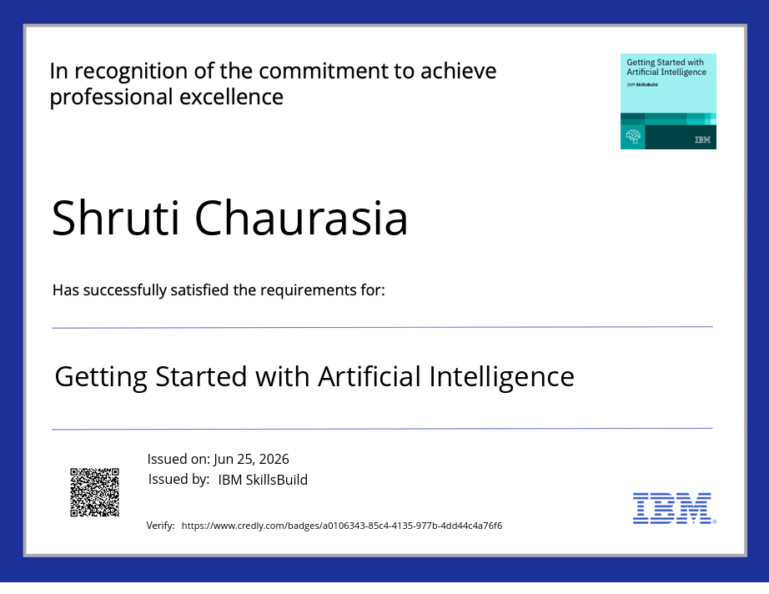
CERTIFICATES EARNED -
1. GETTING STARTED WITH ARTIFICIAL INTELLIGENCE

Slide 23
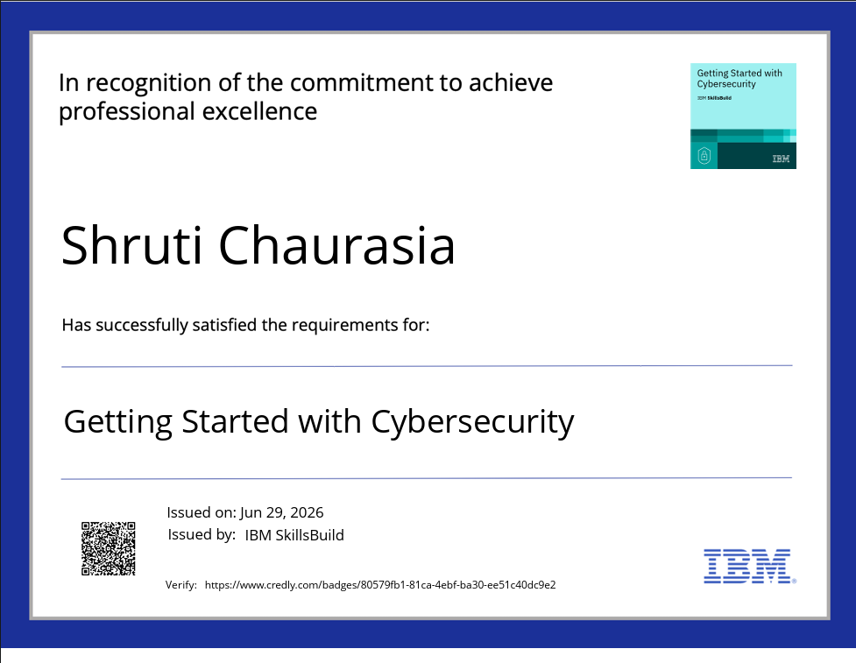
2. GETTING STARTED WITH CYBERSECURITY

Slide 24
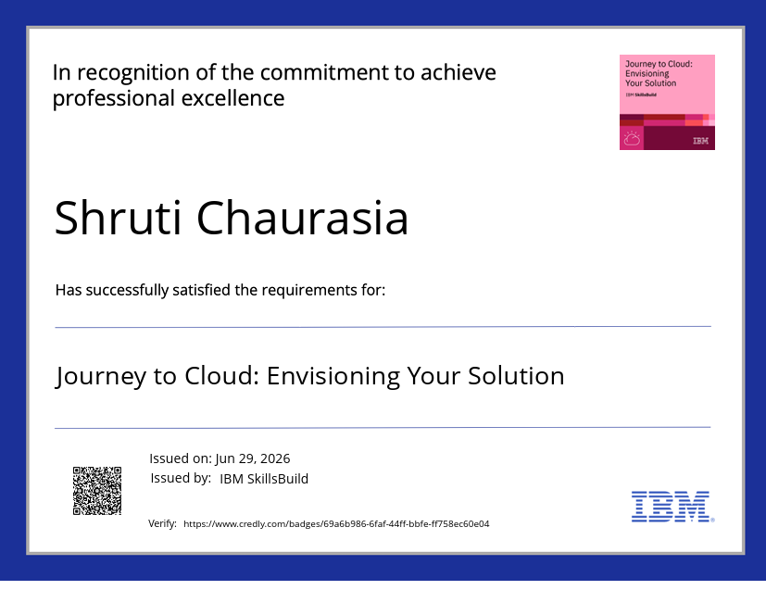
3. JOURNEY TO CLOUD

Slide 25
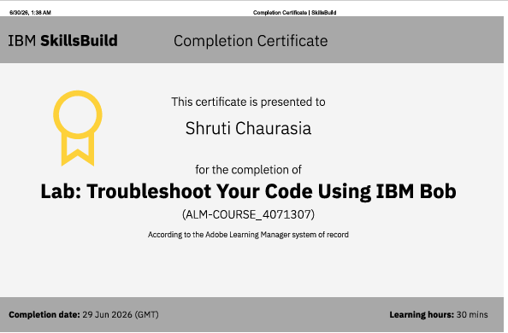
4. TROUBLESHOOT YOUR CODE USING IBM BOB

Slide 26

5. LEVEL UP CYBERSECURITY WITH GEN. AI

Slide 27
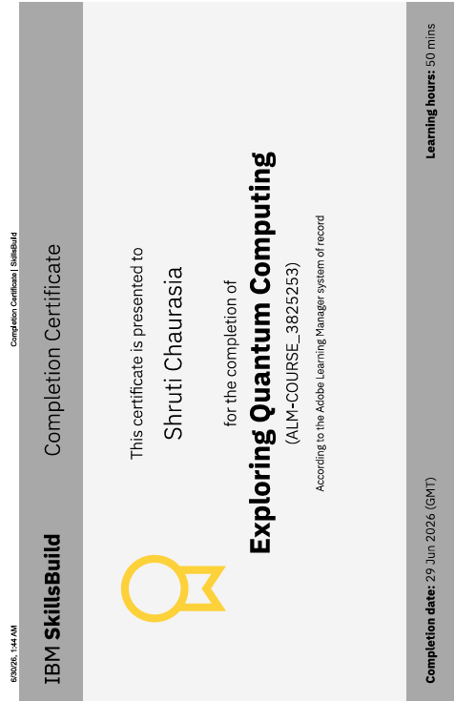
6. EXPLORING QUANTUM COMPUTING

Slide 28


